Slide 1
Reconnection and dynamo in the laboratory
S. Prager

Slide 2
Outline
Reconnection/dynamo effects in fusion plasmas
tokamak
reversed field pinch
Basic reconnection experiments

Slide 3
Reconnection in axisymmetric tori

Slide 4
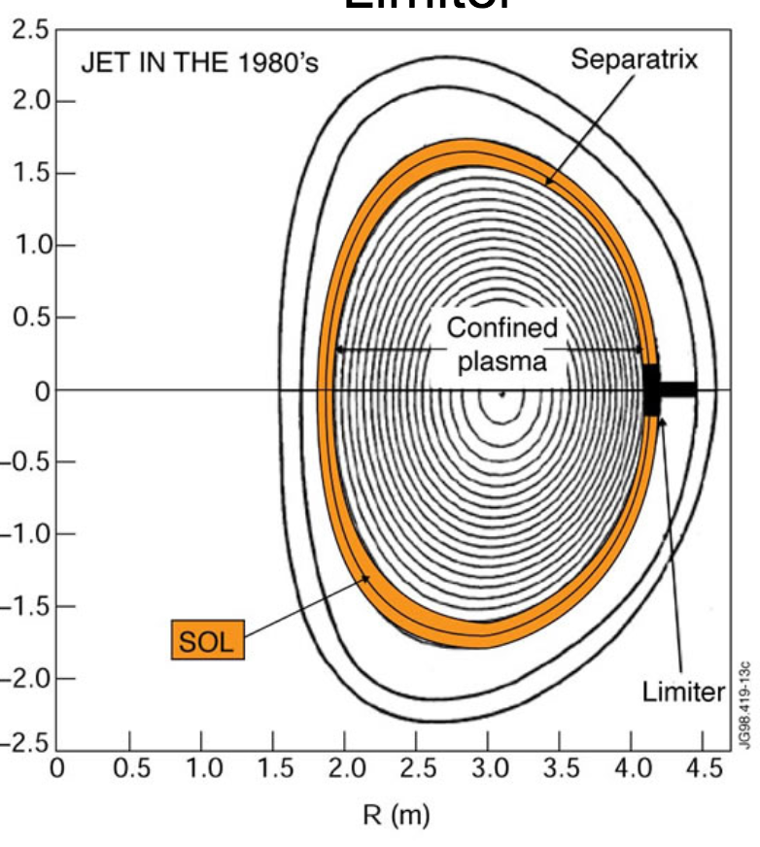
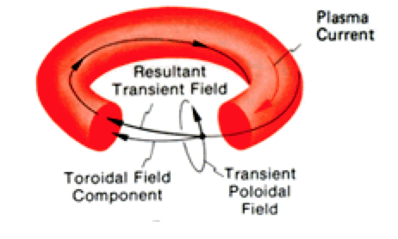
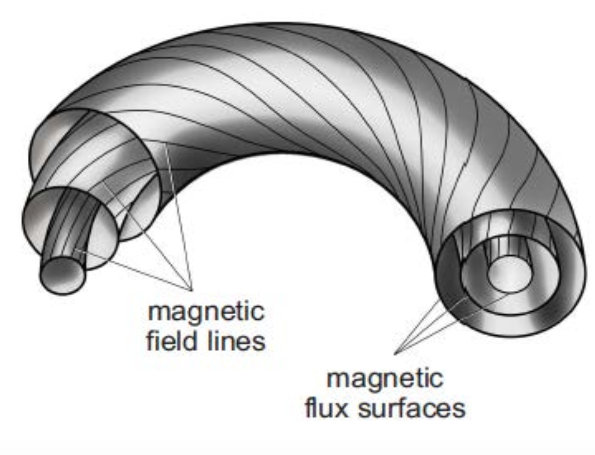
Helical B-lines and magnetic surfaces

Slide 5
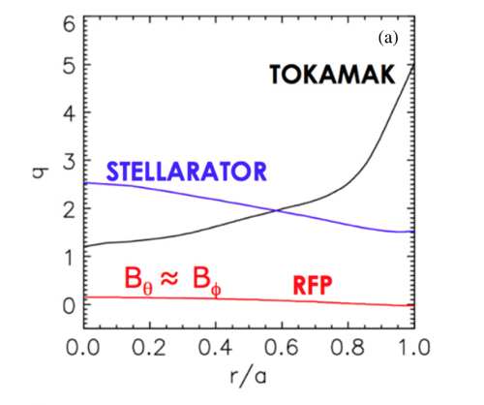
Measure of twist of field lines
$$q= \frac{number of toroidal windings}{poloidal winding}$$
Toroidal $φ$
$$q= \frac{rB_{T}}{RB_{P}}$$
Poloidal $θ$
Safety factor
radial
R

Slide 6
Where does reconnection occur in a torus?
recall, reconnection occurs where
$\vec{B}∙\vec{k}$ = 0 the “reconnecting field”
$$B_{guide}$$
$$∙$$
$$\vec{k}$$
$B= B_{p}$ $\hat{θ}$ + $B_{T}\hat{φ}$
$k=(\frac{m}{r})$ $\hat{θ}$ $−\left(\frac{n}{R}\right)\hat{φ}$
m = poloidal mode number
n = toroidal mode number
$\vec{B}∙\vec{k}$ $=(\frac{m}{r})B_{p}−\left(\frac{n}{R}\right)$ $B_{T}$ = 0
or
$$q= \frac{m}{n}$$
Reconnection occurs on mode-resonant surfaces, or rational surfaces

Slide 7
Where does reconnection occur in a torus?
Where does reconnection occur in a torus?
$$q= \frac{m}{n}$$
$$∙$$
$$∙$$
(3,1)
$$∙$$
$$∙$$
$$∙$$
(2,1)
Show reconnection surfaces for
(m, n) = (2,1), (3,1), (4,3), (3,2)
(4,3)
(3,2)
As m,n increase, the modes become stable

Slide 8
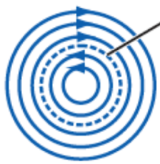
Plot the reconnecting component of B
q = m/n
$\vec{B}∙\vec{k}$ q – m/n
$\sim$
Before reconnection
q = 2/n
Consider reconnection due
to m = 2 perturbation
Magnetic islands form
2 islands since m = 2
after reconnection

Slide 9
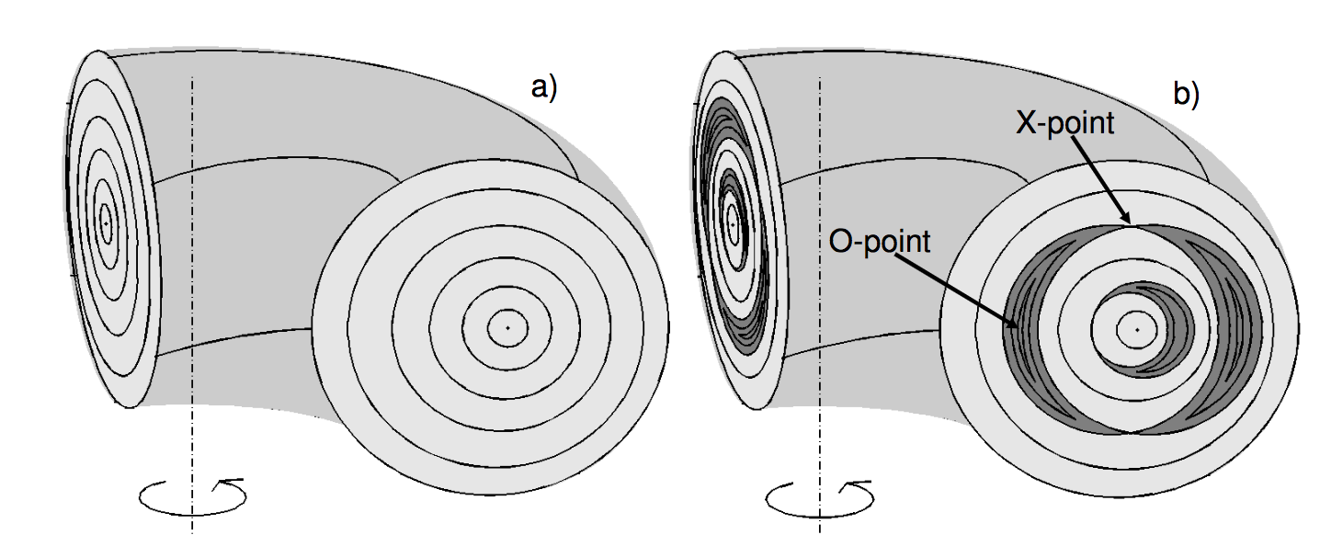
Magnetic surfaces break into islands
Outermost islands:
m = 2, n = 1
at q = 2 surface
innermost islands:
m = 1, n = 1
at q = 1 surface

Slide 10
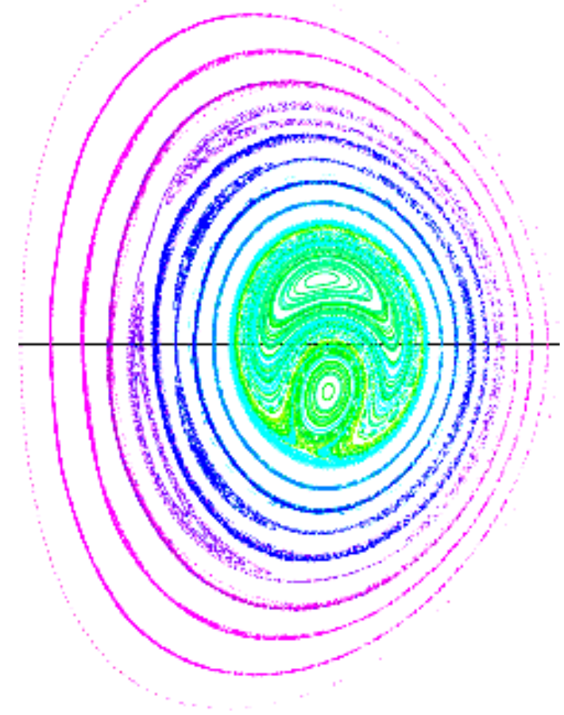
Islands also observed in MHD computation
Puncture plot
Can see islands at
q = 1/1, 3/2 , 2/1 surfaces

Slide 11
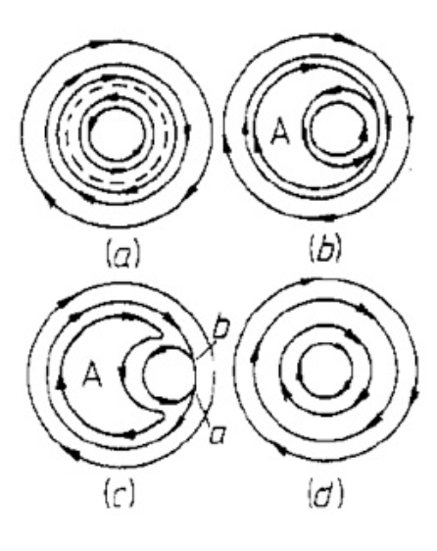
Evolution of reconnection at q = 1 surface
The Kadomtsev model
m = n = 1 island grows, all the way to the center,
Eventually the island central axis (at the q = 1 surface) becomes that of the tokamak
Expect at sawtooth crash:
temperature flattens across island
central safety factor q → 1
The plasma reheats, the current re-peaks, and the process repeats

Slide 12
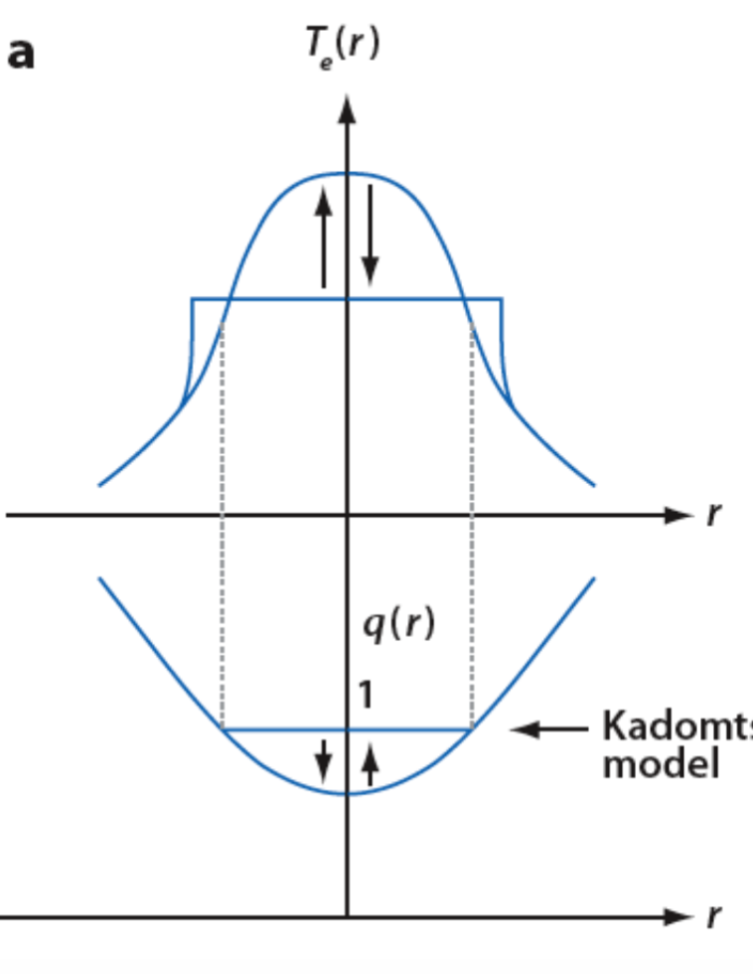
Kadomtsev model of reconnection at q = 1 surface
T_{e}(r)
before reconnection
After reconnection
q(r)

Slide 13
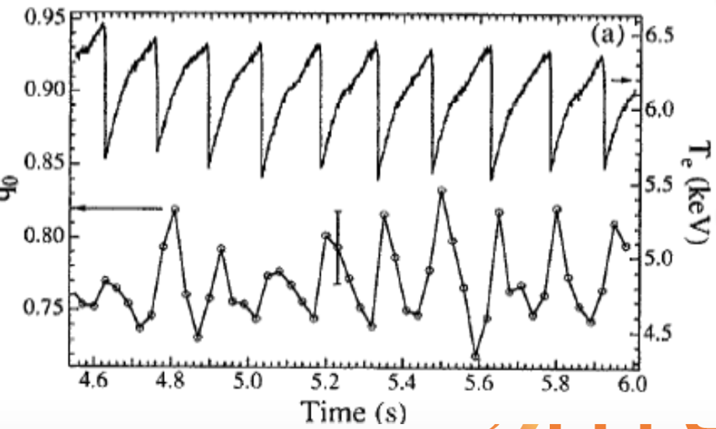
The temperature reduction (energy transport) is observed
6.5
T_{e} (keV)
5.5
4.5

Slide 14
Island structure observed in 2D temperature measurements
Electron temperature evolution

Slide 15
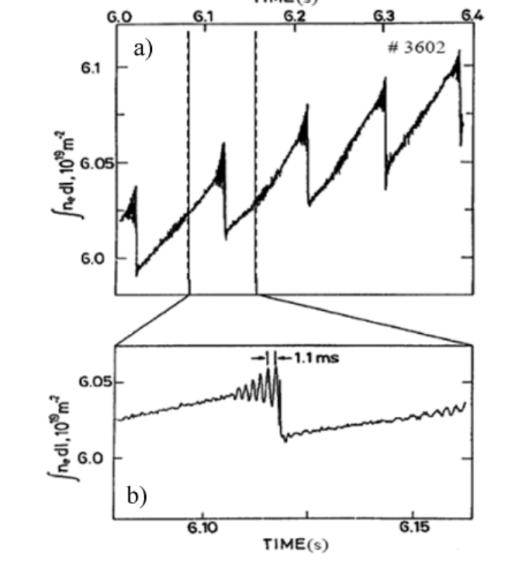
Instability observed to grow prior to reconnection event
Crash observed in density (similar to temperature)
Precursor oscillations
(also observed in magnetic field)

Slide 16
But, q(r=0) does NOT always rise to unity
q(r=0)
Continuing issues: why incomplete reconnection,
why crash so fast?

Slide 17
Axisymmetric tori vary in the strength of reconnection
q $\sim \frac{B_{T}}{B_{P}} \sim \frac{externally produced field}{ internally produced field}\sim \frac{stabilizing influence}{destabilizing influence}$
strong reconnection
moderate reconnection
B_{T} ~ B_{P}
0
1
B_{T} >> B_{P}
q

Slide 18
Reconnection in a torus at low q
Called a “reversed field pinch”
Exhibits strong sawtooth oscillations
Sawtooth crash = reconnection event = “magnetic self-organization”
(current-driven tearing modes re-organize plasma)

Slide 19
RFP facilities

Slide 20
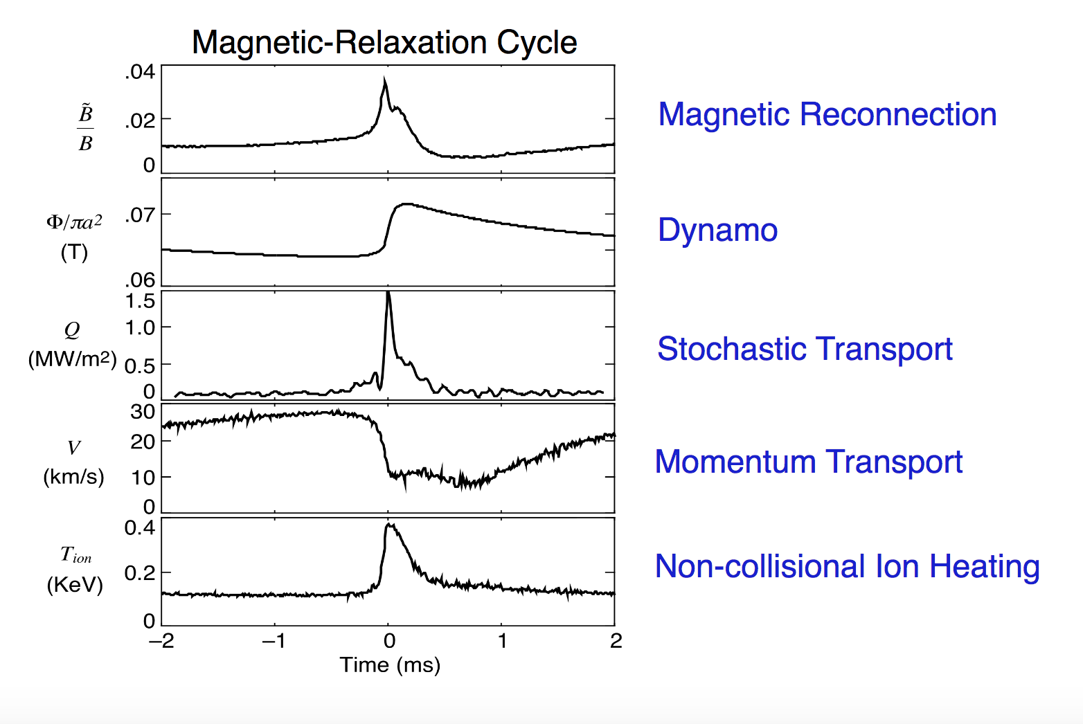
Reconnection (or MSO) event
Magnetic fluctuation
$${\tilde{B}}/B$$
Toroidal magnetic flux
(T)
Heat flux
(MW/m2)
Toroidal rotation velocity
(km/s)
Ion temperature
(keV)
Describe each effect

Slide 21
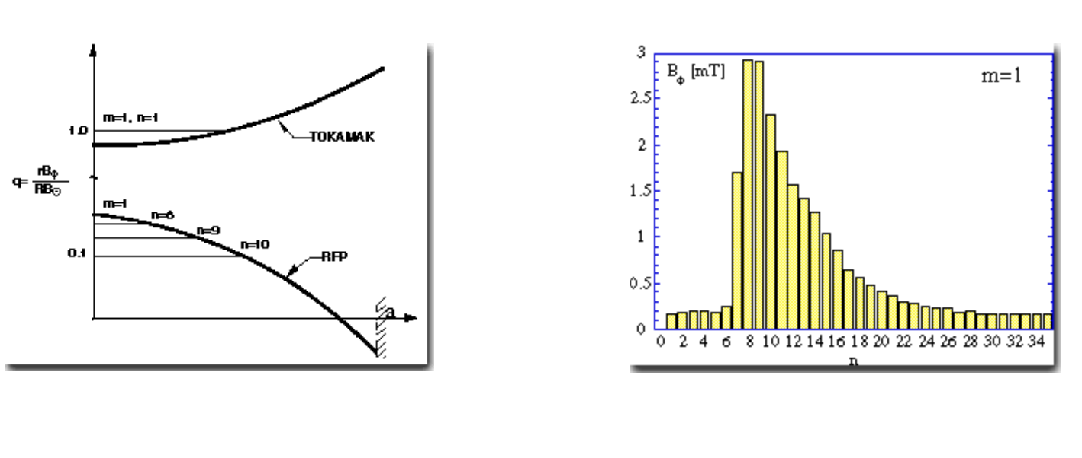
Reconnection: multiple tearing modes
Magnetic field, $\tilde{B(n)}$
Toroidal mode number, n

Slide 22
The many tearing modes interact nonlinearly
$$\frac{∂\vec{B}}{∂t}$$
Let $B_{k}$= $b_{k}e^{i(kx − ωt)}$
Then $\frac{∂b_{k1}}{∂t}$ = $∇ × (v_{k2}$ $×$ $b_{k3}$), where $k_{1}$= $k_{2}$ + $k_{3}$
Nonlinear mode coupling,
Energy flows between modes that satisfy the 3-wave sum rule,
Eigenfunctions for modes with different k values overlap radially
Growing tearing mode saturate by transferring energy to stable modes
(and by flattening the current density profile)
Not fully turbulent, but part way there

Slide 23
Reconnection (or MSO) event
Toroidal magnetic flux
(T)

Slide 24
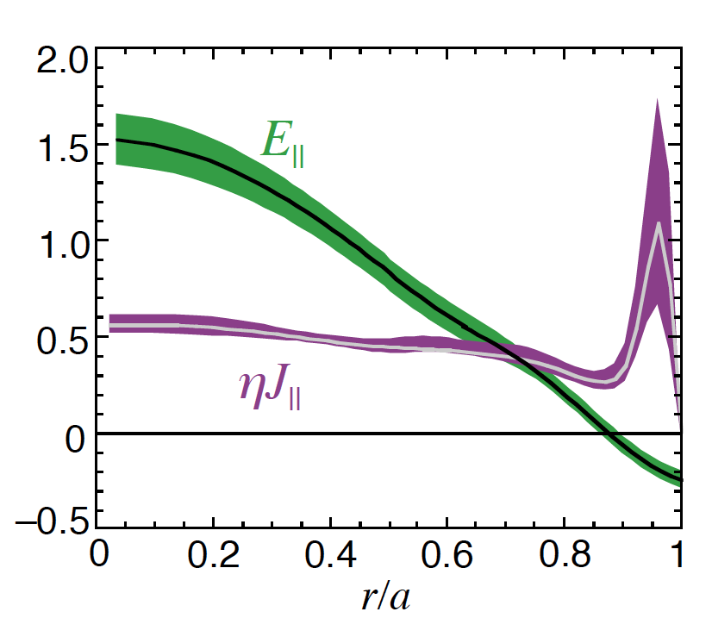
The observed dynamo effect
It is not a full dynamo
Overall magnetic field strength is not increasing
The current density profile is flattening by dynamo processes
Ohm’s law is not satisfied
without considering tearing fluctuations
$E_{||}$ $≠j_{||}$

Slide 25
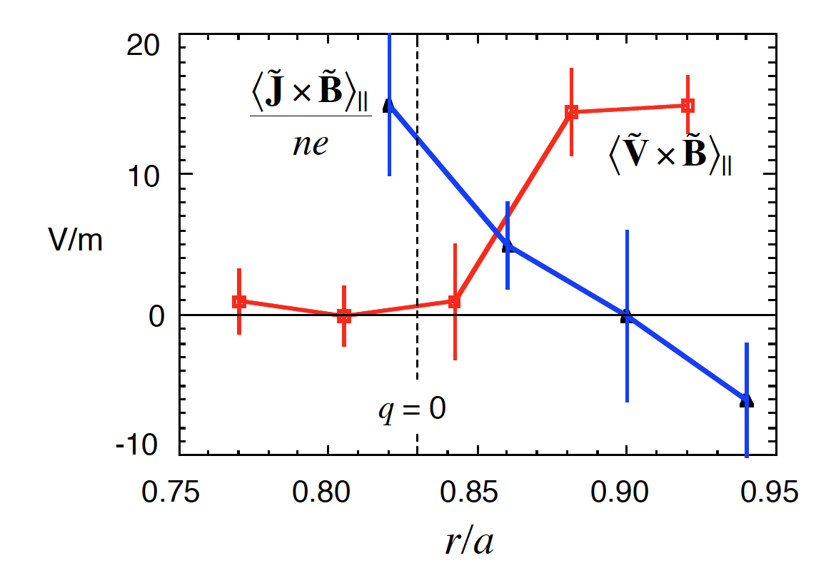
Other mechanisms for current generation
$η\text{<}$j> = <E> + < $\tilde{v}× \tilde{B}$> + $\frac{1}{ne}$ < $\tilde{j}× \tilde{B}>$
MHD dynamo
Hall dynamo
Terms measured in
plasma edge region,
Also important in core
(spectroscopy and
Faraday rotation)

Slide 26
Reconnection (or MSO) event
Heat flux
(MW/m2)

Slide 27
MHD computation of field lines in presence of multiple tearing instabilities
Toroidal angle
Measured energy transport consistent with computed chaotic field
center
edge
radius

Slide 28
Reconnection (or MSO) event
Toroidal rotation velocity
(km/s)

Slide 29
Momentum transport
Sudden change in rotation correlated with reconnection
Rotation increases in edge (transport)
Why is momentum transported?

Slide 30
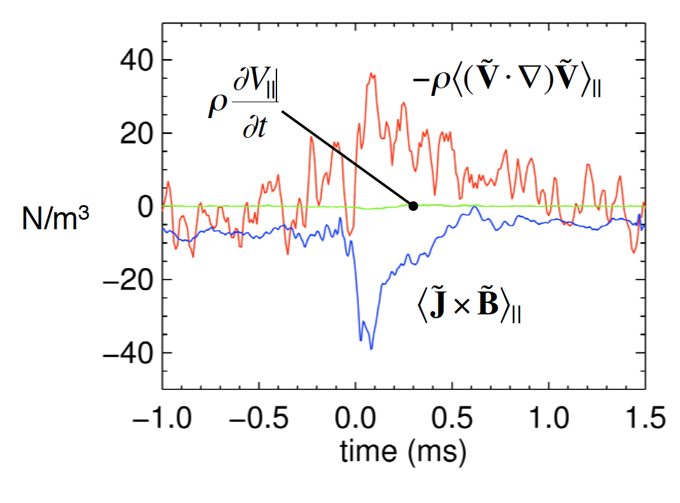
Momentum transport
$ρ$ $\frac{∂<v>}{∂t}$= < $\tilde{j}× \tilde{B}>$- $ρ<\tilde{v}∙$ $∇\tilde{v}>$
Maxwell stress
(related to Hall dynamo)
Reynolds stress
Terms measured
Both effects large and almost cancelling

Slide 31
Reconnection (or MSO) event
Ion temperature

Slide 32
Explanation of ion heating
?????????
Energy source in magnetic energy,
But transfer mechanism not yet known

Slide 33
Control of reconnection and MSO

Slide 34
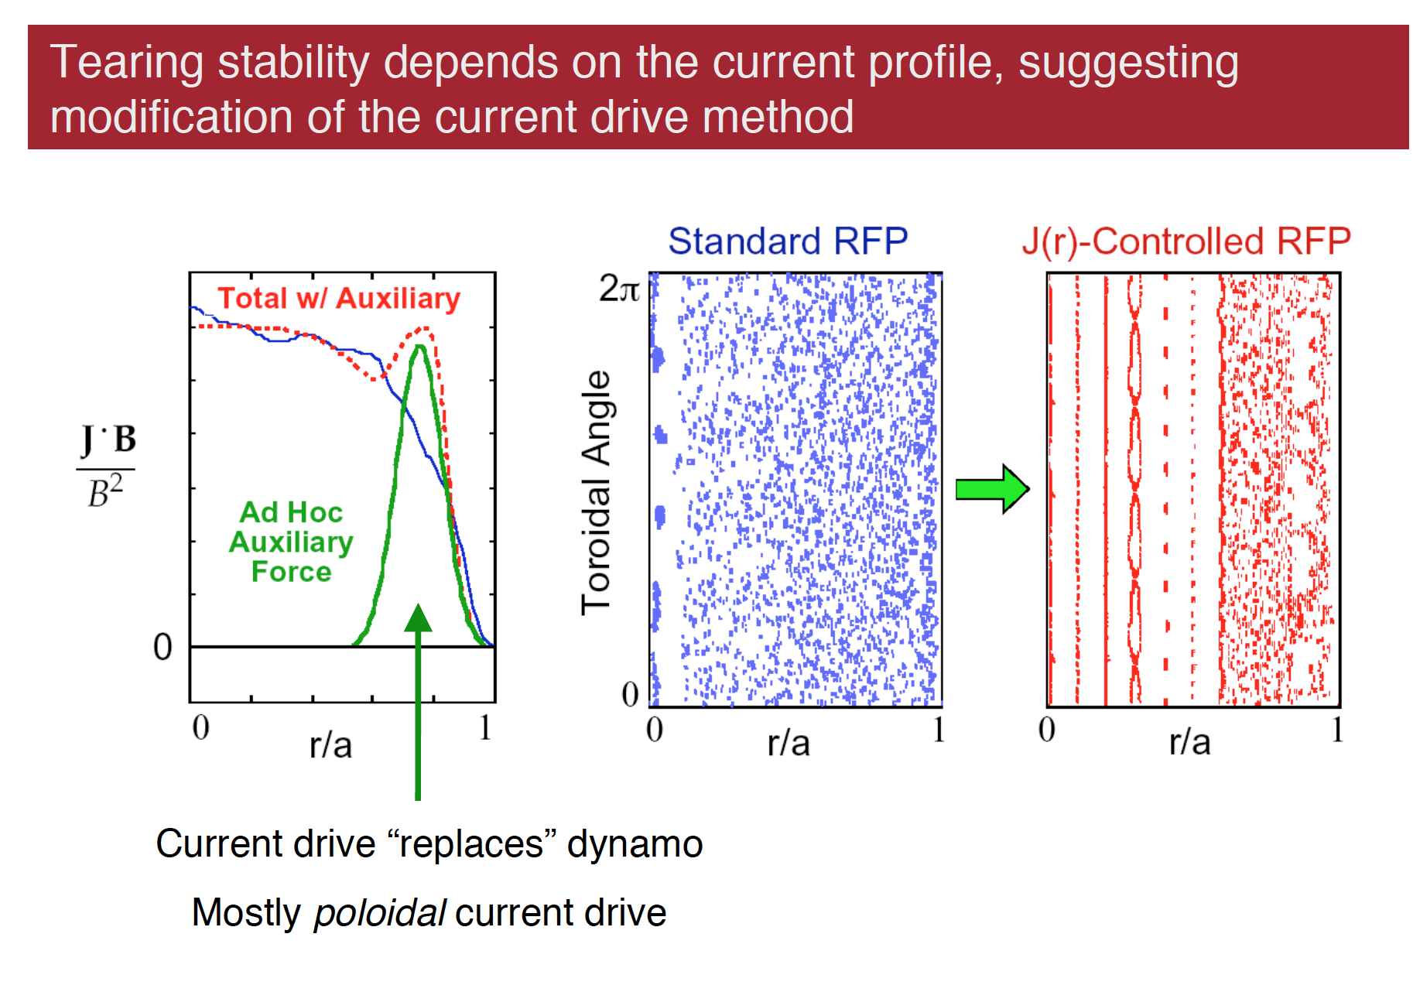
Suppress reconnection (tearing instability) - by driving edge current to reduce dj/dr

Slide 35
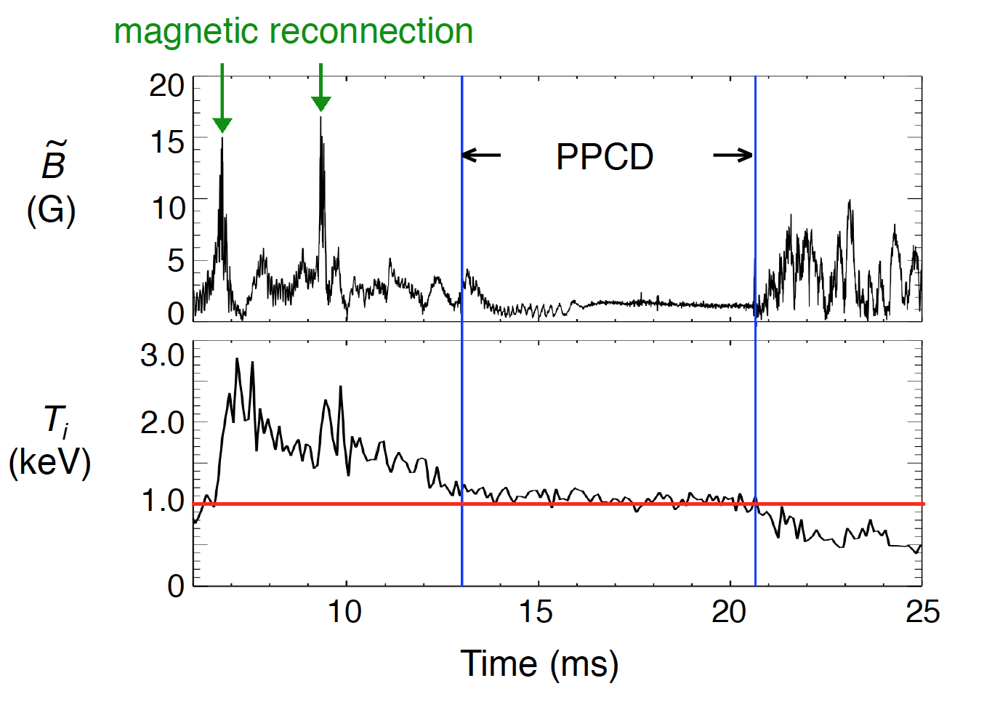
Reconnection and ion heating suppressed

Slide 36
The dynamo disappears
With current control

Slide 37
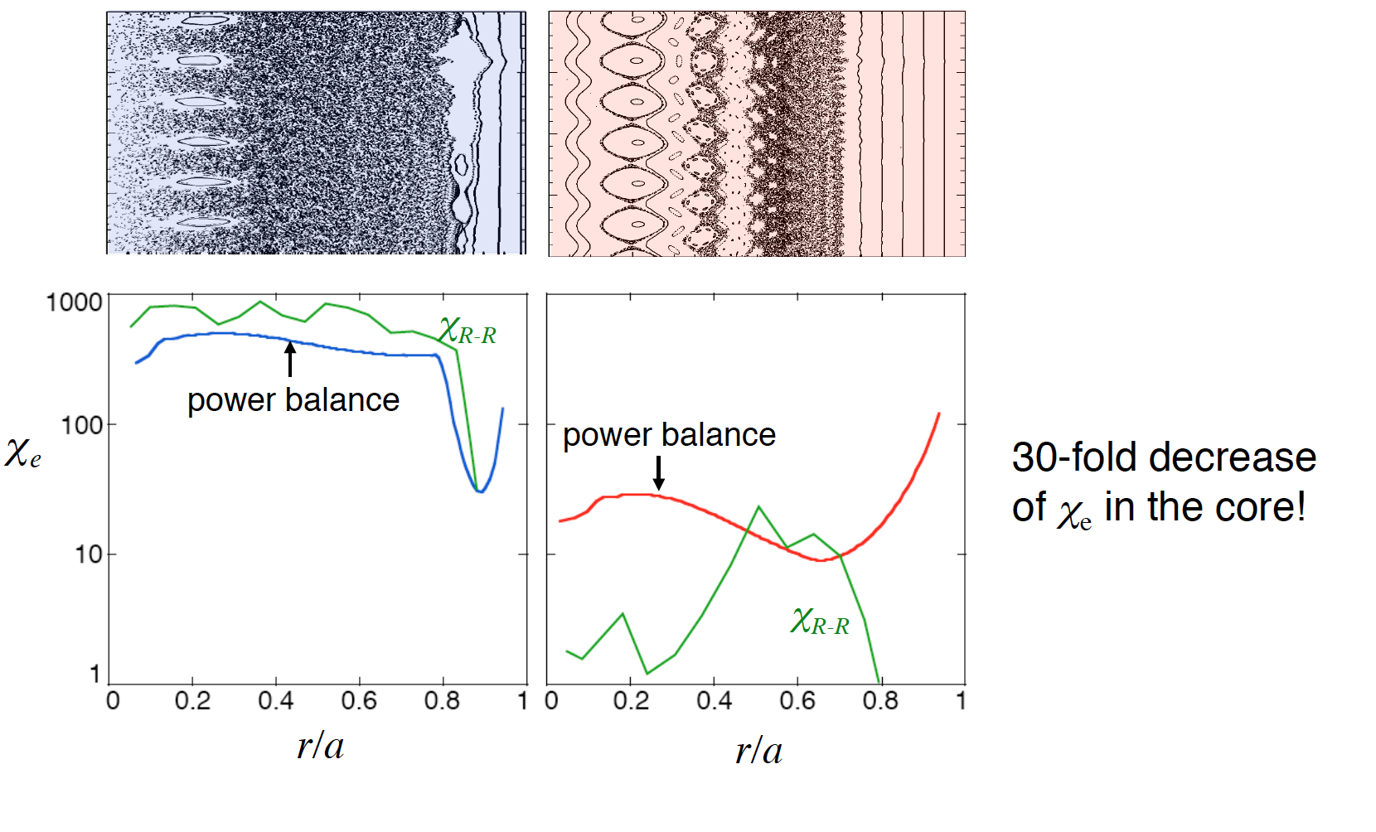
Magnetic chaos and energy transport reduced
Electron thermal diffusivity

Slide 38
Basic reconnection experiments
Set up specifically to investigate reconnection in a controlled manner

Slide 40
Magnetic Reconnection Experiment (MRX)

Slide 41
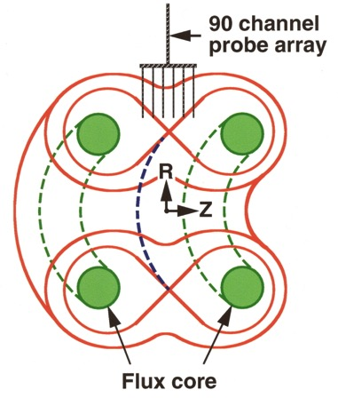
Experimental Setup in MRX
Toroidal current - -> poloidal magnetic field
in coil
Time-varying - -> poloidal E field -> plasma
poloidal current

Slide 42
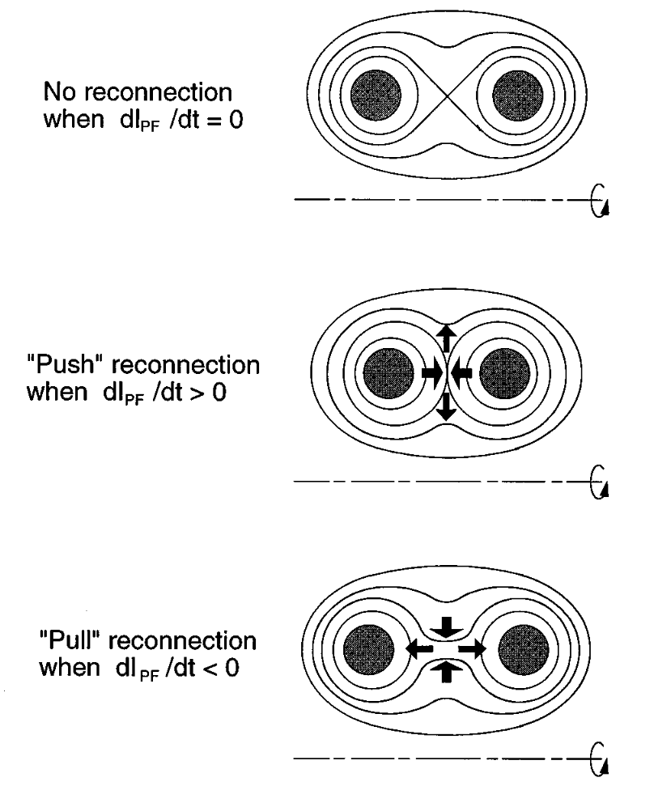
Driving reconnection

Slide 43
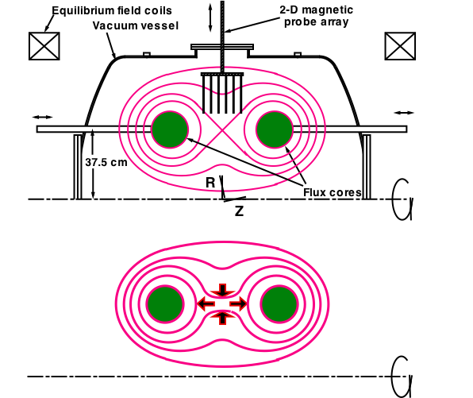
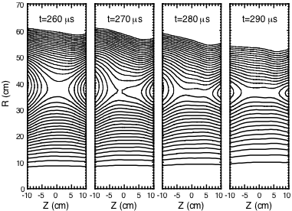
Details of reconnection measured
Experimentally measured flux evolution
n_{e}= 1-10 x10¹³ cm⁻³,
T_{e}~5-15 eV,
B~100-500 G,
S < 1000
Formation of current sheet

Slide 44
Measured transition from MHD to two-fluid regime
$$\frac{E}{ηj}$$
2-fluid
MHD
0.1 1 10
$${d_{i}}/{δ_{SP}}$$
$d_{i}$ = $c/{ω_{pi}}$

Slide 45
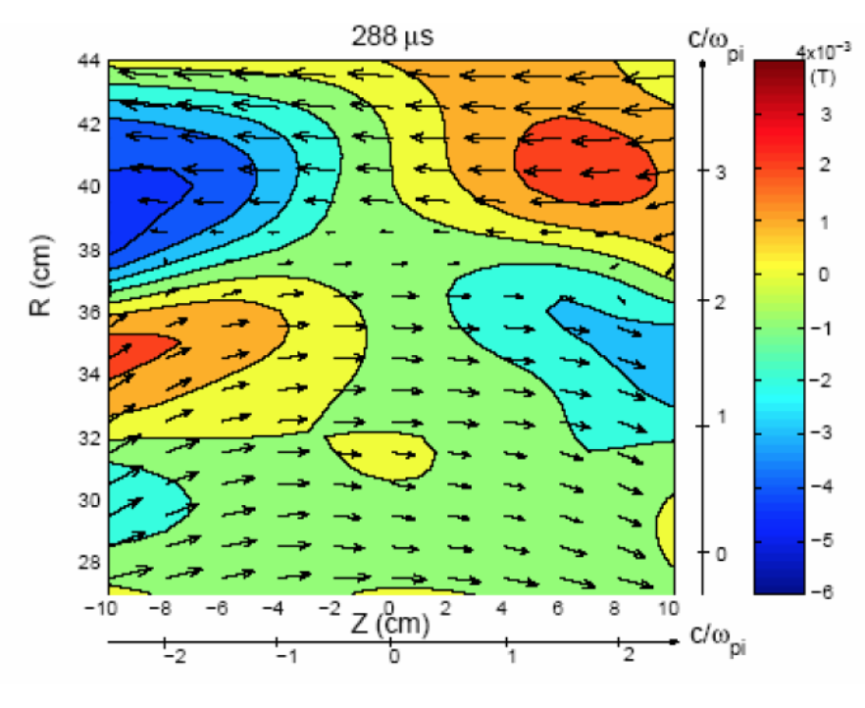
Observe field structure predicted by Hall effect (quadrupolar)

Slide 46
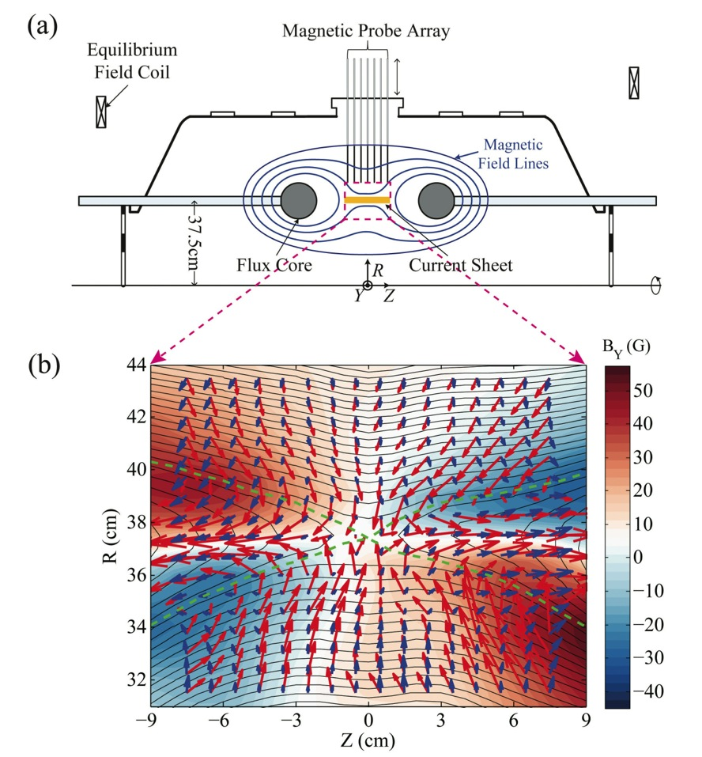
Electron and ion flow velocity measured
The Northern Lights
Electron and ion flow vectors
:
Notes:
2

Slide 47
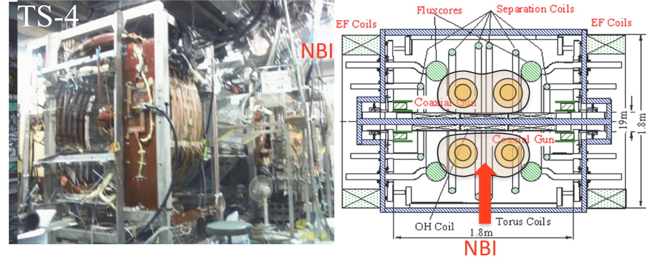
plasma merging device (Tokyo)

Slide 48
Strong ion heating during reconnection

Slide 49
More experiments possibly for Friday lecture
High energy density physics (laser driven)
Liquid metal experiments for dynamo
Other new experiments: Wisconsin, Princeton…

